Slide 1
Go language
Anand Hariharan
Practice Head, Google

Slide 2
Module 5
Error handling, Panic, Recover

Slide 3
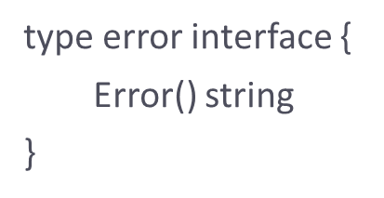
Error handling
For error handling, Go uses a pre-defined interface type called error
Errors are treated as values which can be programmed
Source: https://golang.org

Slide 4
Error handling
Since functions in Go can return multiple values, error is, by convention, the last return value of the function
func <func_name>(msg string) (string, error) {
// implementation
}
Alternatively, one can use the package ‘errors’ as well.

Slide 5
Examples
package main
import (
"errors"
"fmt"
"math"
)
func Sqrt(value float64) (float64, error) {
if value < 0 {
return 0, errors.New("Math: Negative number passed to Sqrt")
}
return math.Sqrt(value), errors.New("Math: No error")
}
func main() {
result, err := Sqrt(-1)
if err != nil {
fmt.Println(err)
} else {
fmt.Println(result)
}
result, err = Sqrt(9)
if err != nil {
fmt.Println(err)
} else {
fmt.Println(result)
}

Slide 6
Defer, Panic & Recover
panic is used when the program, or its part, has reached an unrecoverable state.
It immediately stops execution of the current function and begins unwinding the stack of the goroutine, running any deferred functions along the way. If that unwinding reaches the top of the goroutine's stack, the program dies.
A common use of panic is to abort if a function returns an error value that we don’t know how to (or want to) handle.
Most of the time you won't use panic (you should return an error instead)
Use panic when something goes horribly wrong, probably a programmer error that should have been caught before going to production. This is why it prints the stack.

Slide 7
How Panic works
func panic(v interface{})
When a function F calls panic, normal execution of F stops immediately.
Any functions whose execution was deferred by F are run in the usual way, and then F returns to its caller.
To the caller G, the invocation of F then behaves like a call to panic, terminating G's execution and running any deferred functions. This continues until all functions in the executing goroutine have stopped, in reverse order.

Slide 8
Example – 1 of panic()
package main
import (
"fmt"
)
func main() {
defer fmt.Println("Hello, Message 1")
defer fmt.Println("Hello, Message 2")
panic_example()
}
func panic_example() {
panic("Error")
}

Slide 9
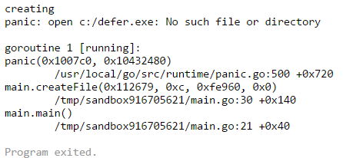
Example - 2 of panic()
func writeFile(f *os.File) {
fmt.Println("writing")
fmt.Fprintln(f, "data")
}
func closeFile(f *os.File) {
fmt.Println("closing")
f.Close()
}
package main
import "fmt"
import "os«
func main() {
f := createFile("c:/defer.exe")
defer closeFile(f)
writeFile(f)
}
func createFile(p string) *os.File {
fmt.Println("creating")
f, err := os.Create(p)
if err != nil {
panic(err)
}
return f
}

Slide 10
Recover
Recover is a built-in function that regains control of a panicking goroutine.
Recover is only useful inside deferred functions.
During normal execution, a call to recover will return nil and have no other effect.
If the current goroutine is panicking, a call to recover will capture the value given to panic and resume normal execution.

Slide 11
Example – recover()
package main
import (
"fmt"
)
func main() {
defer func(){
fmt.Println("Recovering from panic")
recover()
//r:=recover()
//fmt.Println(r)
}()
panic_example()
}
func panic_example() {
panic("Panic message")
}

Slide 12
Anand Hariharan
Practice Head
anand.hariharan@wipro.com

